Slide 1
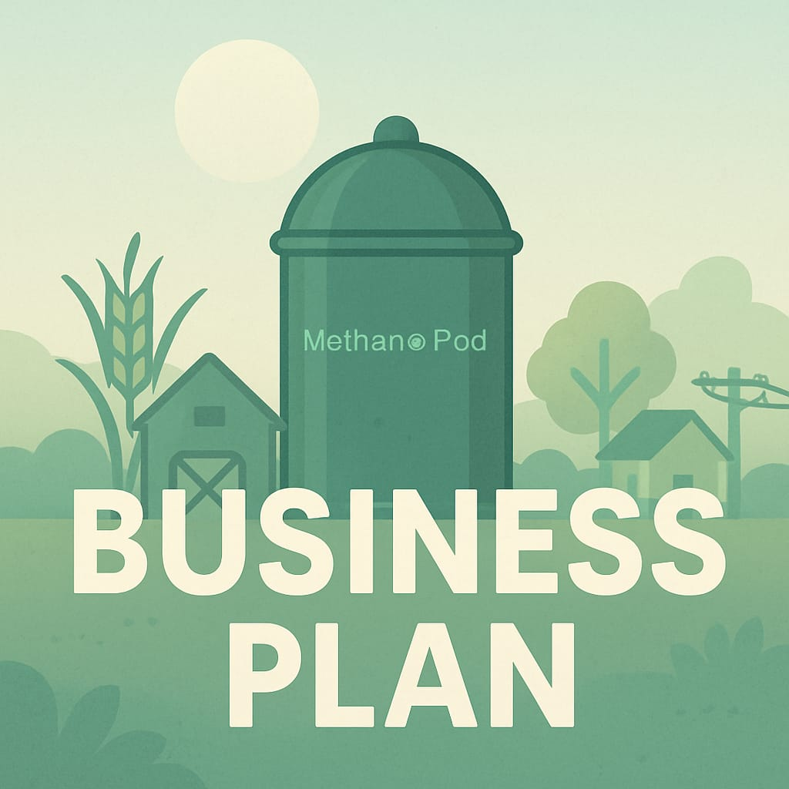
BUSINESS PLAN
IDENTIFYING THE PROBLEM- SEEDING THE BUSINESS IDEA
PRESENTATION BY –
KHUSHI CHAUDHARY
RAKHI RAJPUT
PREETI RAIKWAR
POOJA
ARYA SWAROOP

Slide 2

TABLE OF CONTENTS
BUSINESS IDEA
TECHNOLOGY AND PROCESS
IMPACT AND BENEFIT ON ENVIRONMENT
BUSINESS MODEL
SWOT ANALYSIS
PESTEL ANALYSIS
CUSTOMER PERSONA

Slide 3
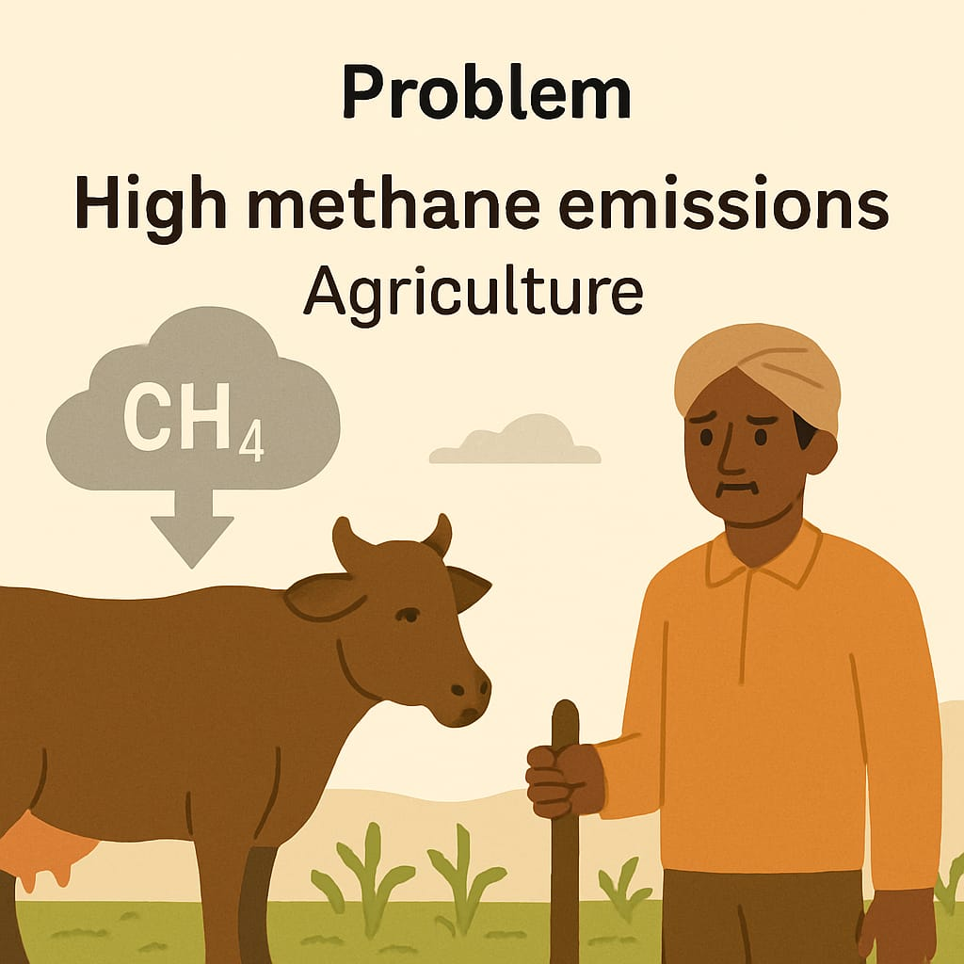
Problem: High Methane Emissions from Agriculture
Why It Matters:
Methane (CH₄) is a greenhouse gas that is 84x more potent than CO₂ over a 20-year period.
Agriculture contributes ~40% of global methane emissions, mainly from: Enteric fermentation, rice paddies , manure management
Current Status:
This problem is under-addressed in India and many developing countries.
No widespread tech solutions at the village or farm level to manage methane.
Farmers have no incentive or system to reduce methane on their own

Slide 4
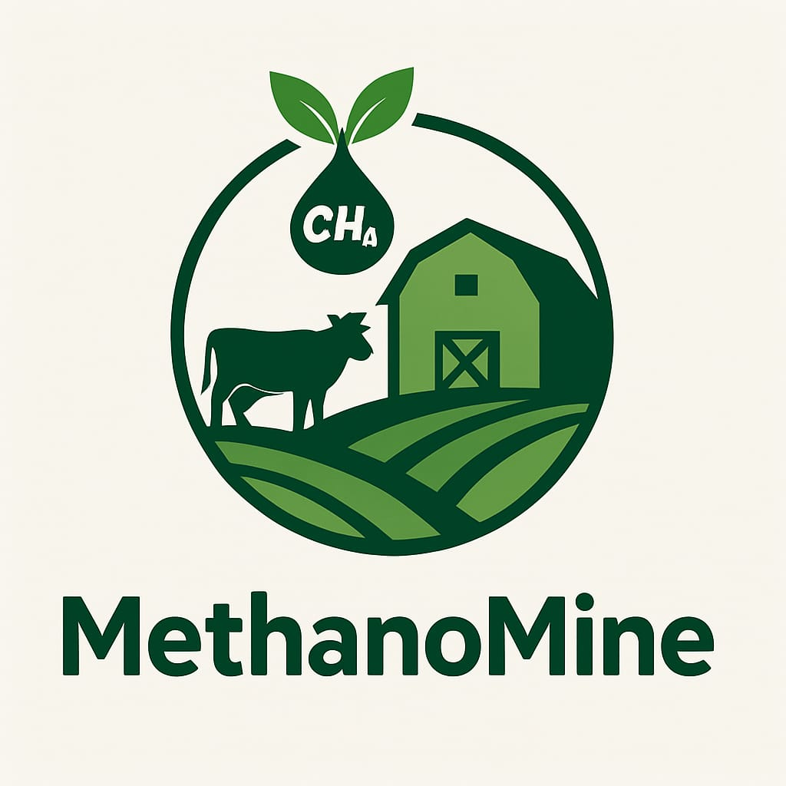
MethanoMine –
MethanoMine is an innovative, village-scale solution that captures methane emissions from agriculture—like cow dung, rice paddies, and manure pits—and converts them into clean energy, compost, or biomass using modular, low-cost "MethanoPods".
The Concept:
Set up modular methane capture plants at the village level near:
Dairy clusters
Rice fields
Community manure dumps.
These plants capture methane and either:
Convert it into biogas/electricity
Convert it into value-added products (like biochar or compost)
Use methanotroph microbes to convert methane into CO₂ and biomass, which is less harmful and can be used as feed or fertilizer

Slide 5
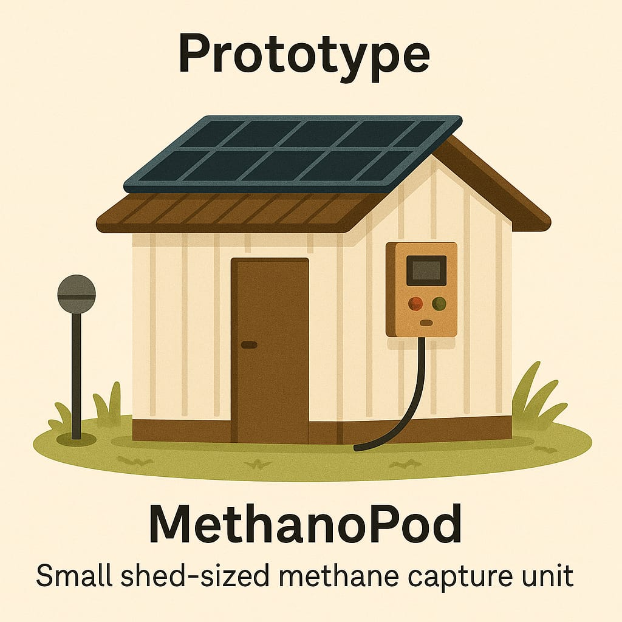
How It Works:
Prototype / Product Idea:
“MethanoPods” – Small, Scalable Methane Capture Units
Each pod is the size of a small shed
Can be set up near cow sheds, manure pits, or rice fields
Modular design, easy to assemble and maintain
Equipped with sensors and a basic control system
Operates on solar or minimal grid electricity
1. Methane Capture Mechanism
Anaerobic digesters or covered lagoons for cow manure and paddy fields
Low-cost bio-covers trap methane and direct it to a central chamber
In rice fields: alternate wetting and drying (AWD) + piping network captures CH₄
2. Methane-to-Energy or Biomass Conversion
Install microbial bio-reactors that use methanotrophs (natural bacteria that “eat” methane)
These bacteria convert methane into non-toxic biomass, usable as fertilizer, fish feed, or compost
Alternatively, use methane as fuel for rural cooking or electricity

Slide 6
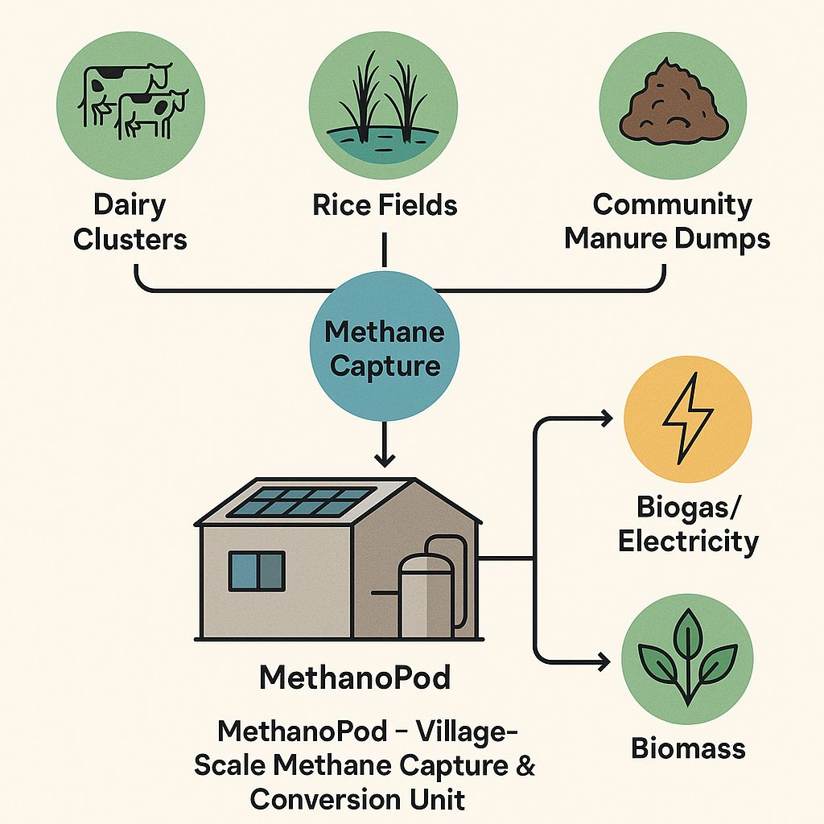
Technology & Process
Covered anaerobic digesters for manure and livestock waste
Bio-covers over paddy fields connected to a methane collection pipe network
Conversion options:
Biogas/Electricity – Burn methane for cooking fuel or rural power generation
Biomass via methanotroph bacteria – Bacteria consume methane and produce biomass for fertilizer or fish feed
Modular unit (“MethanoPod”) features:
Small shed-sized unit, solar-powered controls
Sensors for gas monitoring and system regulation
Easy to assemble, maintain, and relocate

Slide 7

Impact & Benefits
Reduce methane emissions in target areas by 50–70%
Lower overall greenhouse gas footprint of agriculture
Economic:
Provide low-cost cooking gas or electricity to rural households
Generate income from by-products and carbon credits
Social:
Create local employment opportunities
Support sustainable farming practices
Global alignment:
Meets SDG goals for climate action, clean energy, and sustainable agriculture

Slide 8
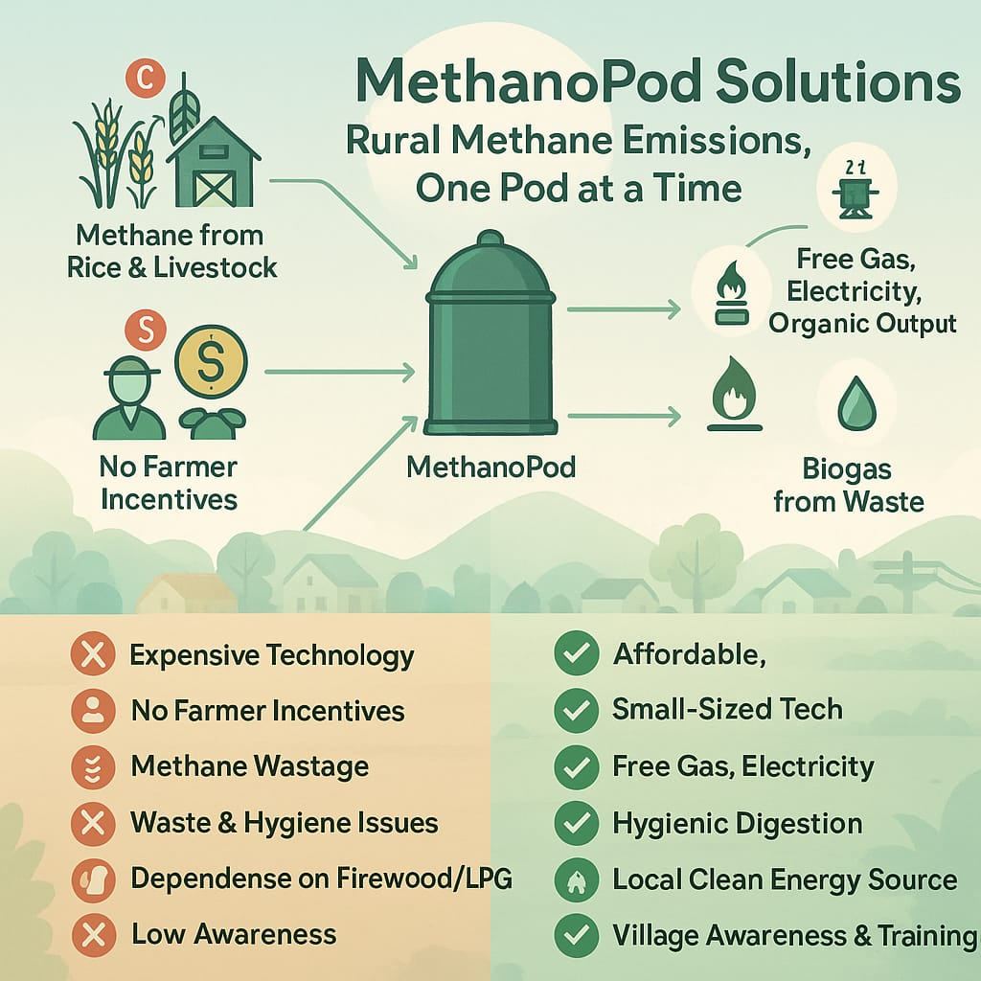

Slide 9
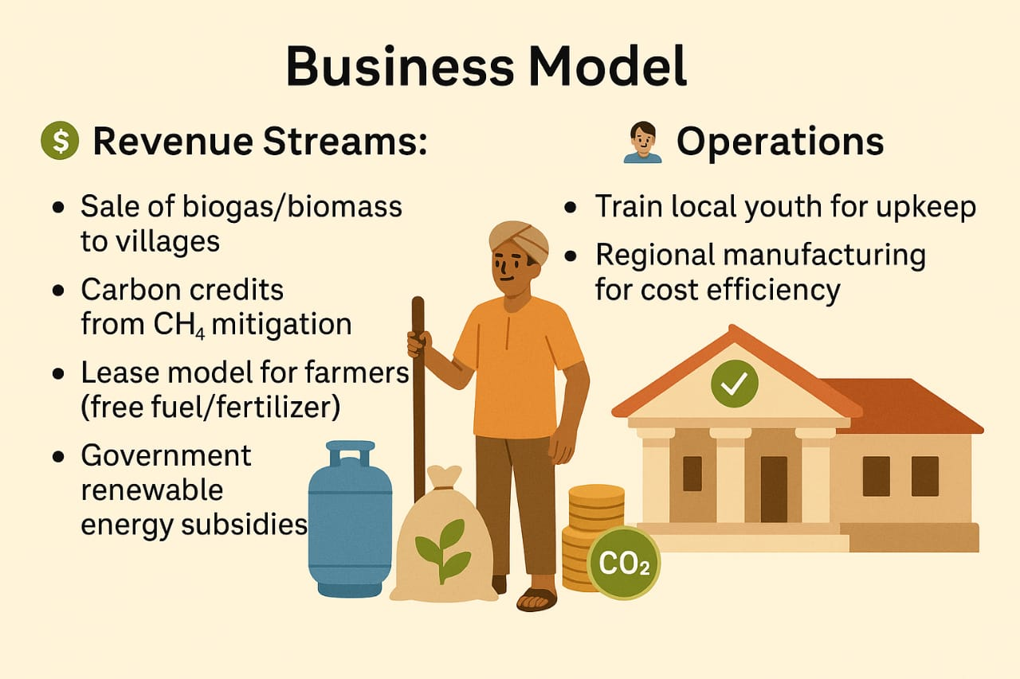

Slide 10
SWOT
STRENGTHS
OPPORTUNITIES
WEAKNESSES
THREATS
1.Modular, scalable methane solution
for rural areas.
2.Generates income via gas, biomass,
and carbon credits.
1.Government subsidies and carbon
markets support adoption.
2.Rising rural demand for clean
energy solutions.
1.High upfront cost and technical
training required.
2.Success depends on local
participation and awareness.
1.Competes with solar, LPG, and
Other renewables. 2.Safety, cultural, and technical
risks in early stages.

Slide 11
PESTEL Analysis
Factor | Key Points
Political | Govt. biogas schemes (NBMMP) offer 30–40% subsidies. Global Methane Pledge supports growth.
Economic | Carbon credits & fuel savings offer strong ROI. High initial cost remains a key barrier.
Social | Improves rural energy access, health & livelihoods. Needs awareness & cultural acceptance.
Technological | Modular design & remote sensors boost scalability. Training needed to manage methane systems.
Environmental | Cuts potent methane emissions; aids circular farming. Supports waste-to-energy and soil health.
Legal | Must follow biogas safety and waste rules. Certification needed for carbon credit claims.

Slide 12
Customer Persona
Point | Details
Name & Profile | Ramesh Kumar Singh, 42, dairy farmer & small-scale rice cultivator, Rural UP, joint family of 6, 2 acres paddy + 10–15 dairy cattle
Goals & Motivations | Reduce fuel costs, eliminate manure smell, improve crop yield, increase income from surplus biogas/biomass, support eco-friendly practices
Buying Behavior | Influenced by community leaders and cooperative members, prefers demos, trusts local providers, willing to pay if savings and low maintenance assured
Key Product Expectations | Affordable with subsidies/financing, simple operation, durable design for rural conditions, quick ROI (2–3 years), continuous support and training
Marketing Channels | Village awareness programs, KVK demos, WhatsApp videos, regional pamphlets, partnerships with dairy cooperatives & agri-input dealers

Slide 13


